Slide 1
Stratospheric Influences on Sub-seasonal Climate Variability
Presenters Name:
Wes Lee Johnson
Mentor’s Name:
Senior Research Scientist Lon Hood of The Lunar and Planetary Laboratory at the University of Arizona

Slide 2

Importance of the Research:
Many atmospheric models don’t fully incorporate stratospheric effects.
These stratospheric effects can influence sub-seasonal climate variability.
Therefore we need to study the stratosphere to improve atmospheric models and long term weather forecasts.

Slide 3
Methods
The European Centre for Medium-Range Weather Forecasts (ECMWF) ERA-Interim reanalysis data set is analyzed.
The data is generated via data assimilation: together clever statistics and large computers combine observational data and weather model predictions to give a global data set starting in 1979.
We use precipitation and sea level pressure data (among other variables not discussed in this talk) to study a pattern of sub-seasonal weather variability called the Madden‐Julian oscillation (MJO).

Slide 4
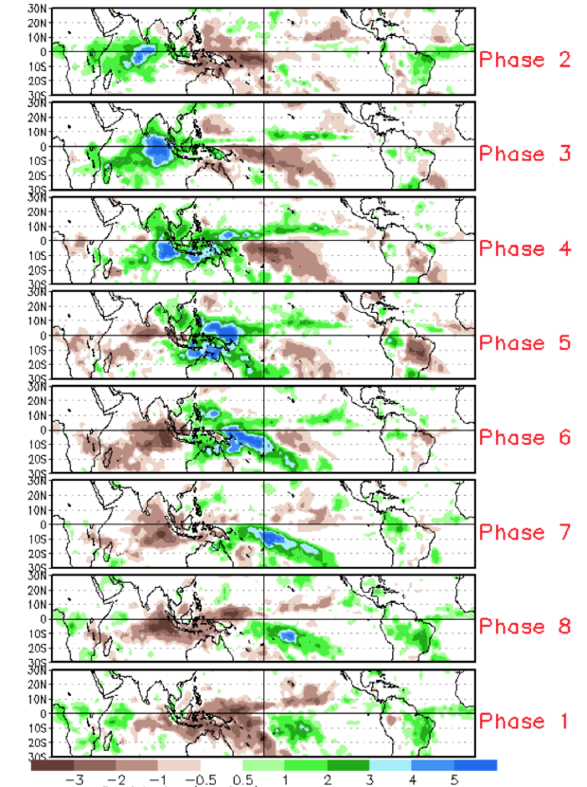
The MJO
The Madden Julian Oscillation (MJO) is a sub-seasonal (30 to 90-day) variation of tropical convection and precipitation that produces effects on weather outside of the tropics (similar to El Nino but on a shorter time scale).
The MJO has 8 phases.
The MJO both suppresses and increases precipitation.
Credit: Jon Gottschalck
Average Rainfall

Slide 5
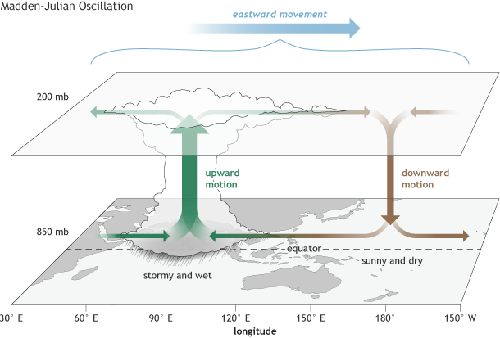
Credit: Cici Zhang

Slide 6
How does the stratosphere affect the MJO?
In our research we focus on the Solar Cycle’s effects and the Quasi-Biennial Oscillation’s (QBO) effects.
Let’s focus on how QBO affects the MJO.
But first… What is the QBO?

Slide 7
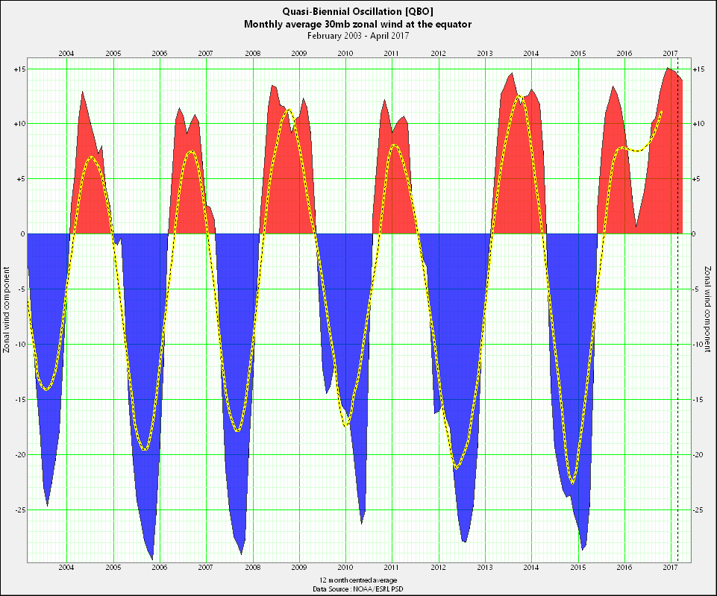
The QBO
The Quasi-Biennial Oscillation (QBO) is a stratospheric wind pattern with an east and west phase.
Red: West Phase
Blue: East Phase
Credit: Xmetman

Slide 8
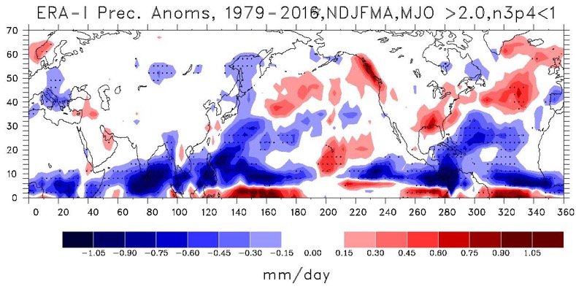
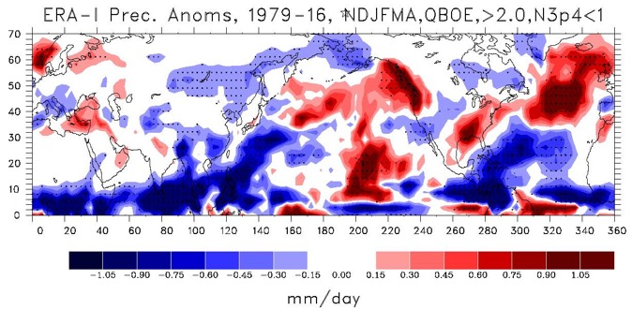
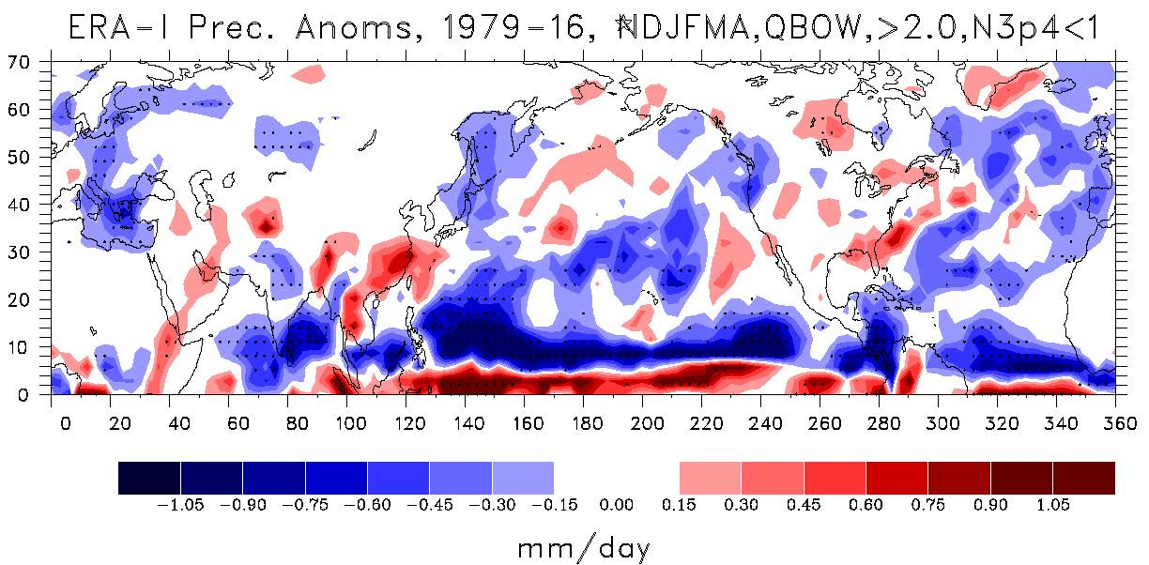
All Data:
Note: Periods of strong ENSO are excluded and only days when the MJO is active are considered.
Precipitation Anomaly 1979-16 all MJO phases Events w/o ENSO during NDJFMA
Calculated from ERA-Interim Reanalysis meteorological data.
East Phase:
Millimeter Per Day
West Phase:
Precipitation Anomaly 1979-16 all MJO phases Events w/o ENSO during NDJFMA
Precipitation Anomaly 1979-16 all MJO phases Events w/o ENSO during NDJFMA
Millimeter Per Day
Millimeter Per Day

Slide 9
Rossby Wave
The QBO in its east phase strengthens the MJO sea level pressure anomalies.
The MJO is starting a Rossby Wave-train
This extends the MJO’s effects outside the tropics.
hPa
hPa
hPa

Slide 10
Conclusion
We have identified the QBO as a factor in MJO behavior making the stratosphere an important factor in understanding/predicting sub-seasonal climate variability.
This illustrates the importance of incorporating the stratospheric influences in atmospheric models.
We hope our research will be applied to improve long range weather forecasts.

Slide 11
Acknowledgements
Thanks to the Arizona Space Grant Consortium and the NSF Climate and Large-Scale Dynamics Program for funding.
Special thanks to my excellent mentor Lon Hood!
Thanks to Michelle Coe and every NASA Space Grant Coordinator.

Slide 13
Measurements
We use the European Reanalysis data (ERA Interim) data.
This data are created in a process called data assimilation.
Observational data from satellites, weather balloons, and weather stations are fed into global weather models.
Their predictions are compared with actual data and the model’s predictions become better over time.
The ERA reanalysis data contains temperature and precipitation data across the whole globe that span back 39 years (among many other variables).

Slide 14
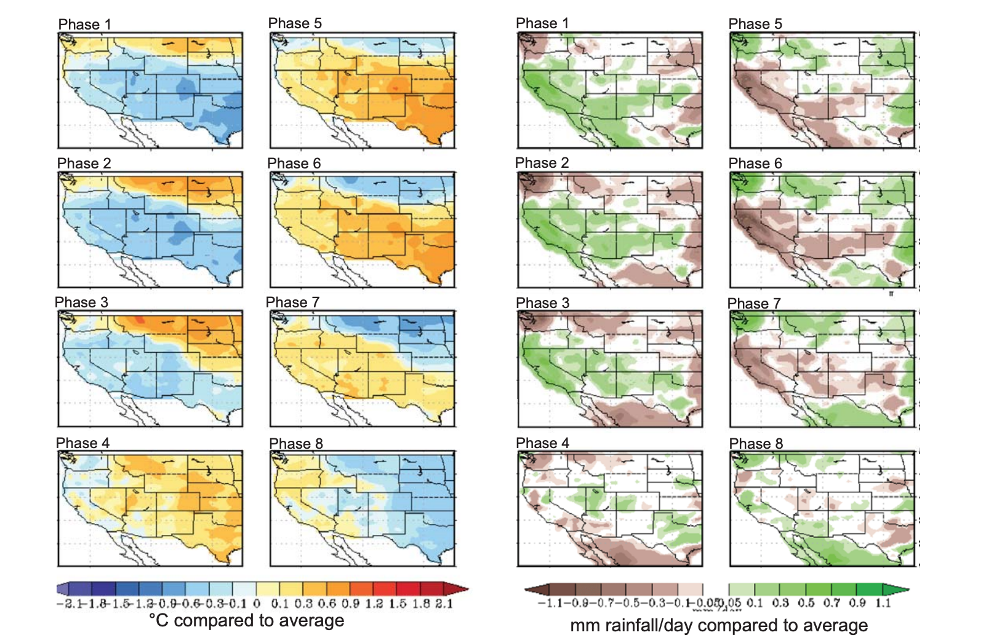

Slide 15
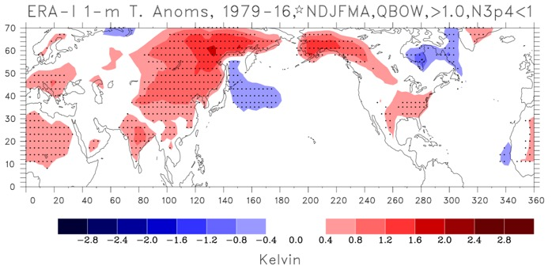
This plot shows the difference between the surface air temperature during the QBO West phase and the average temperature (anomaly).
Note: Periods of strong ENSO events are excluded and only days when the MJO is active are considered.

Slide 16
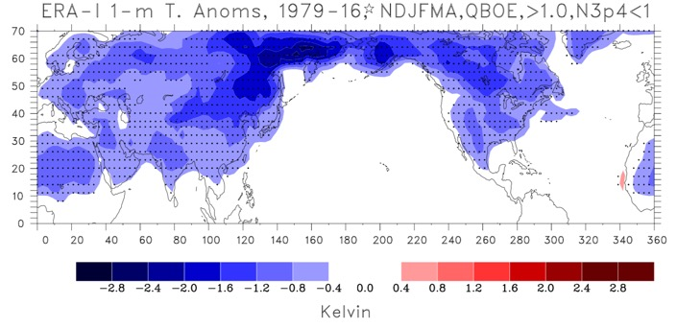
This plot shows the difference between the surface temperature during the QBO East phase and the average temperature (anomaly).
Note: Periods of strong ENSO events are excluded and only days when the MJO is active are considered.

Slide 17
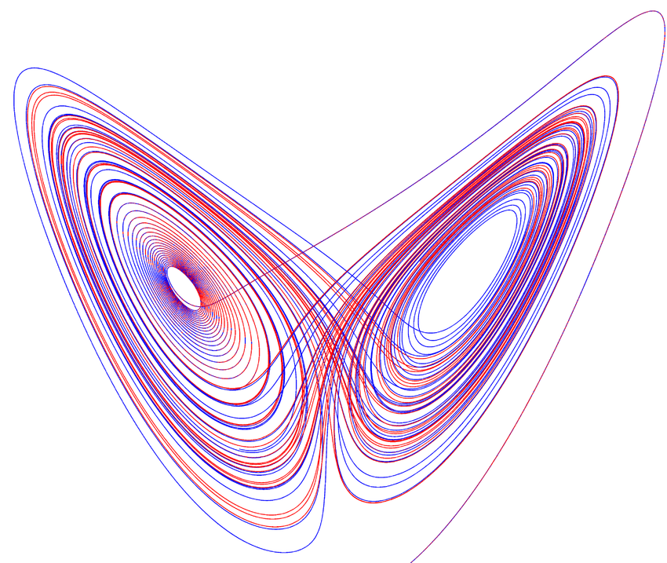
Credit: Gustavo Moreira, Carlos & Pacifico, Maria & Romaña, Sergio.

